Slide 1
Quantum Monte Carlo
Variational and Diffusion

Slide 2
Motivation
So far we have seen Monte Carlo techniques that take advantage of probability – where quantum phenomena are probabilistic, Monte Carlo is a good candidate to solve quantum problems
Many quantum problems may not be solved analytically due to difficulties in solving integrals or differential equations. This is often due to complicated potentials.
Many real world systems are many-body problems, but cannot be solved analytically – Monte Carlo systems are developed to find approximate solutions.
Quantities that may be found by Monte Carlo methods are ground state energy, ground state wavefunction, and ground state probability density. Other expectation values are possible for VMC
Two examples of quantum Monte Carlo: Variational and Diffusion

Slide 3
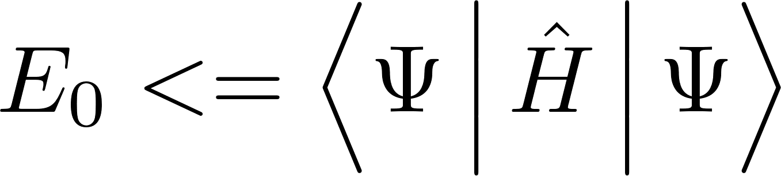
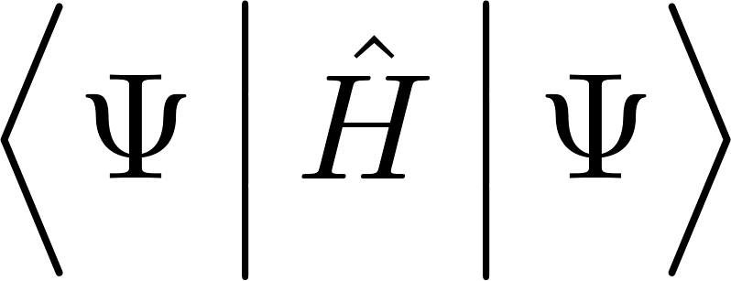
Variational Monte Carlo
Based on the variational principal:
This allows us to choose any wavefunction with any set of parameters and minimize the expectation value of this wavefunction
The most obvious challenges and limitations is trying to find a good wavefunction and needing the Hamiltonian of the system
  Trial wavefunction and its derivative must be continuous
  The expectation value must exist:

Slide 4
VMC Algorithm
Propose a move
Evaluate probability ratio
Metropolis accept/reject
Update electron positions and parameters
Calculate local energy
Output
Initial setup

Slide 5
Why not QMC?
QMC is more accurate, but there are more constraints on which systems can be used.
QMC simulations are computationally expensive

Slide 6
A Common Alternative
A more common substitute is Density-Functional Theory (DFT), which is generally less accurate, but faster and more flexible to apply to other fields
  Increased efficiency comes from replacing the electron-electron Coulomb interaction with a single pseudopotential and other approximations
  DFT also has problems, such as simulating van der Waals bonding, which is more accurate with QMC

Slide 7
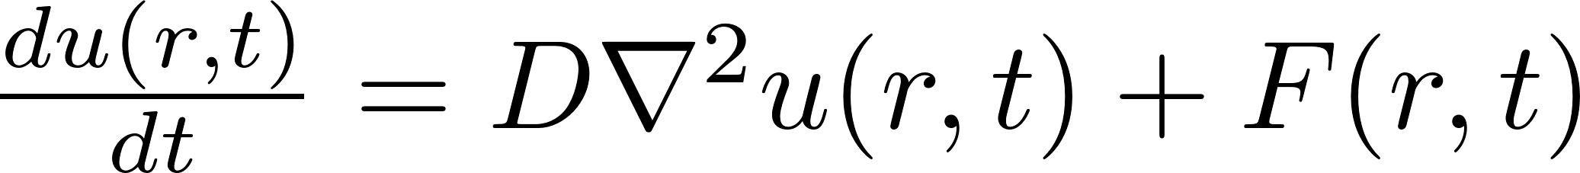
Diffusion
Simulating a system with imaginary parameters is difficult – it would be easier to simulate something real
Diffusion Monte Carlo relies on turning the Schrodinger equation into a diffusion equation
The result of simulating a real differential equation will be the same as the Schrodinger equation
Allows for the calculation of the ground state wavefunction and the ground state energy

Slide 8
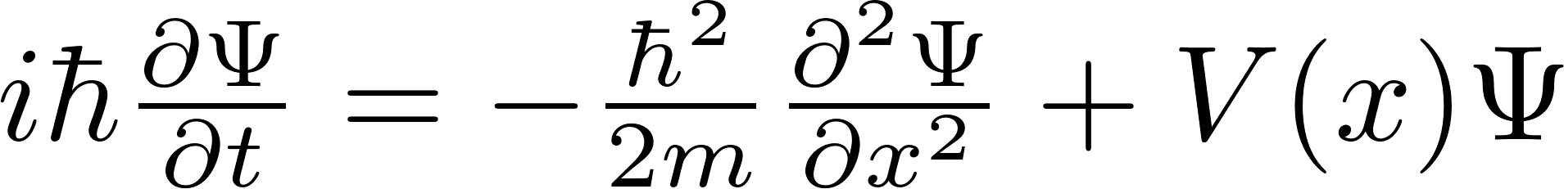
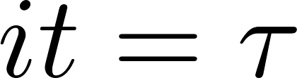
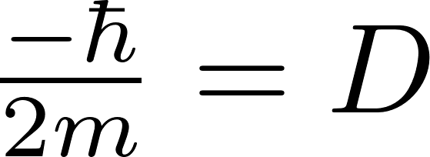
PDEs
To begin, the Schrodinger equation is transformed into a diffusion equation. Starting with the familiar 1D Schrodinger equation:
Two substitutions need to be made: one to convert time to ‘imaginary time’ and another to define the diffusion term.
Performing the substitution, the result is
In the 3 dimensional form used for diffusion Monte Carlo:

Slide 9
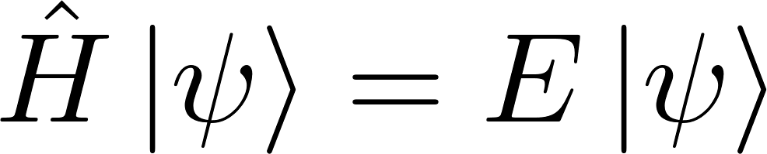
Reference Eigenvalue
In order to make diffusion monte carlo useful, the potential energy used needs to be re-defined. A ‘reference energy’ term is added to the potential, assuming that it is an eigenvalue of the quantum state of the system.
Hence, the modified value is also an eigen-energy of the system corresponding to a modified Hamiltonian operator

Slide 10
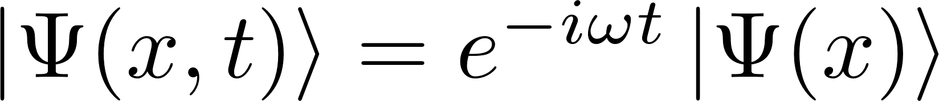
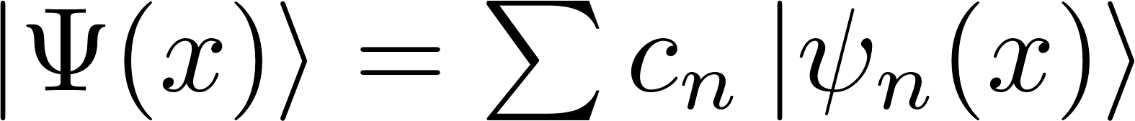
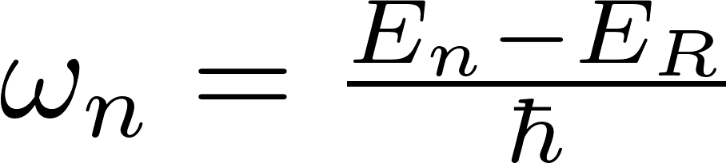
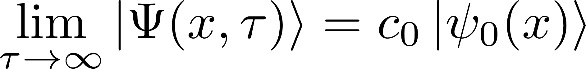
Time Evolution
The reference energy is used in conjunction with the time evolution of a quantum system. When using imaginary time, all eigenstates except for the ground state will decay away as time approaches infinity. Recall the following
Applying appropriate substitutions:
When all the above are brought together at the limit:
The only term that survives is when omega is zero, meaning when the reference energy is the ground state

Slide 11
Diffusion Equation
DIFFUSION
CREATION/DESTRUCTION
Our original diffusion equation is a superposition of two equations: a diffusion term and a forcing term.
By simulating each term sequentially, we may simulate the entire system.
Each step in the simulation is a step in imaginary time
After enough steps, the system will decay to the ground state system, with the reference energy E₀ and a wavefunction matching the ground state

Slide 12
Simulation 1
Prior to this method other studies examined random diffusion
Brownian motion, for instance, is also simulated by diffusion
Diffusion may be simulated using random walks. A number of walkers are created, and are allowed to move some distance each time interval. The distance is normally distributed.
Unlike other Monte Carlo methods, a random walk is always accepted, regardless of the potential in that region
After each diffusion step, the second simulation takes place

Slide 13
Simulation 2
After each diffusion step, the walkers are either created, destroyed, or multiply based on how likely a walker is to exist at that potential. In areas of low potential, more walkers will be created. In areas of high potential, walkers are destroyed.
The simulation considers 4 possibilities:
  Destruction: the walker is destroyed
  Stasis: the walker remains
  Growth: a new walker is created at the location
  Extreme Growth: two new walkers are created at this location

Slide 14
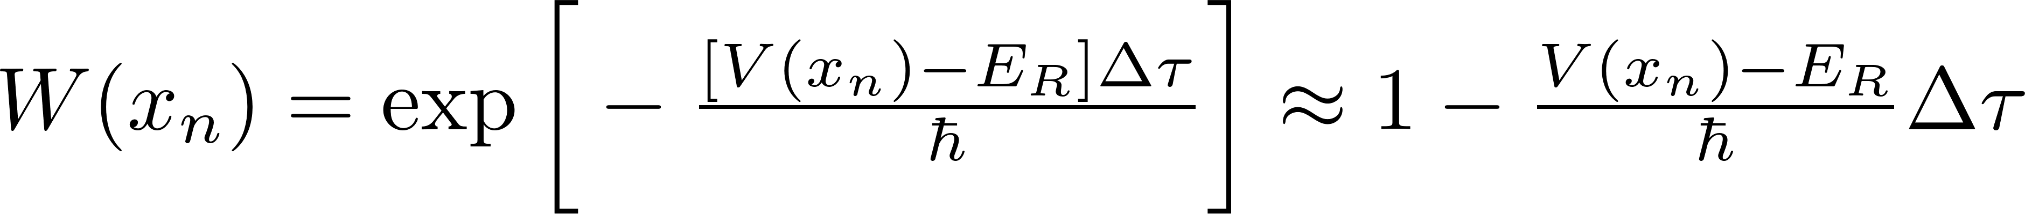
Weighting
Whether particles are created, destroyed, or left alone is governed by the weighting function. This may be derived using Green’s functions or Feynman path integrals.
The weighting function is rounded to the nearest integer.
A maximum value cap of W=3 is applied in the code to prevent occasional simulations with massive numbers of walkers

Slide 15
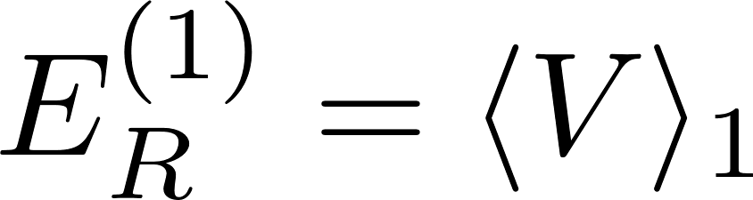
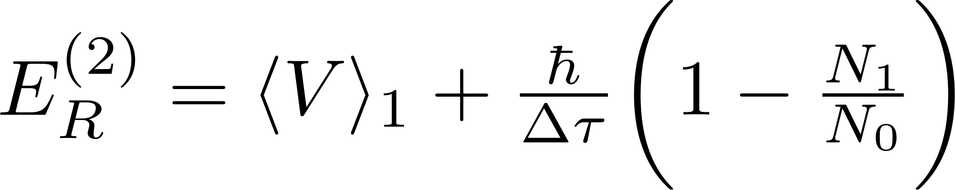
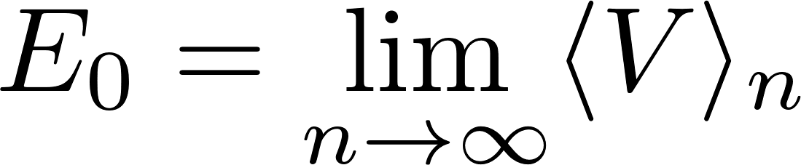
Ground Energy
Like most Monte Carlo methods, an initial guess is used for the reference energy.
After the first time step, the reference energy is guessed to be the expectation value of the potential from the previous walkers
We can hone in on the ground state by knowing that the system will eventually reach an equilibrium: the ground state.
As we approach the ground state, the number of walkers should be constant.
We may use this to find the ground state. If the number of walkers increases, the reference energy should increase to reduce the number of walkers and vice versa.
Over time, this yields an equilibrium

Slide 16
Algorithm
Advance Time
Step
Initialize
Random Walk
Adjust E
Results
Compute Weight
Binning
*Burn In
Delete / Add

